Slide 1
Metadata Evaluation and Guidance for Curation and Improvement
Sean Gordon
(scgordon@hdfgroup.org)
Ted Habermann
John Kozimor
The HDF Group

Slide 2
Terminology
Collection: A group of metadata records, commonly organized by a data center, organization or project and often stored in a database or web accessible folder.
Concept : General term for describing a documentation entity (e.g. Title, Revision Date, Process Step, Spatial Extent).
Dialect : A particular form of the documentation language that is specific to a community (e.g. ISO, DIF, CSDGM, EML, ECHO).
Recommendation: A set of concepts that a group believes is required for achieving a documentation goal.
Profile: A set of concepts required to support a particular documentation need or use case for a recommendation.

Slide 3
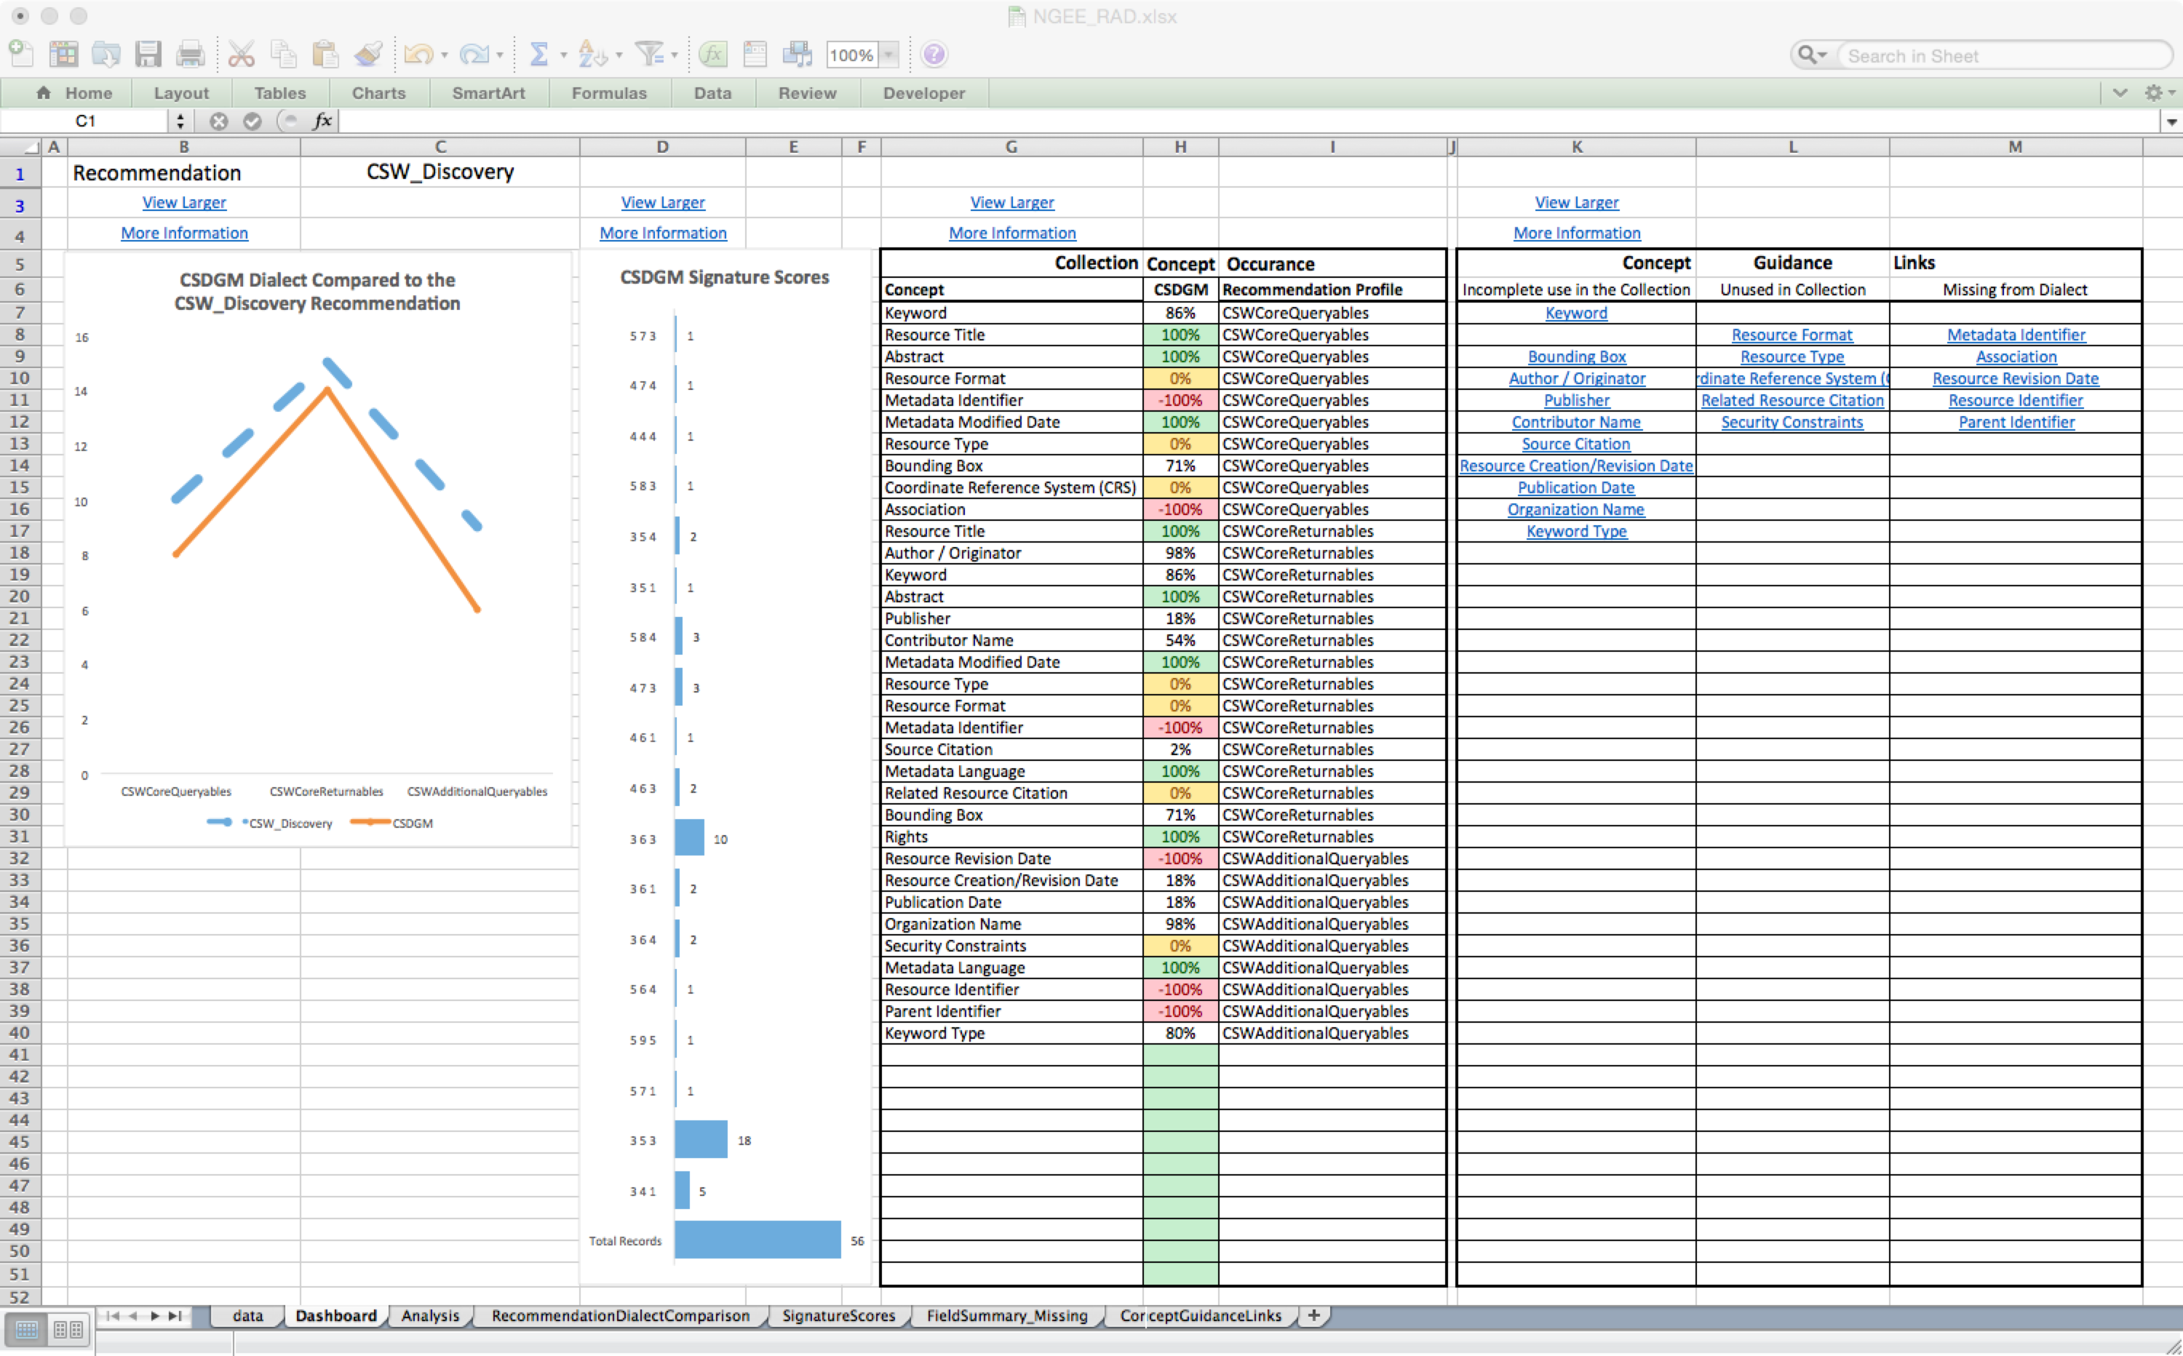
Recommendations Analysis Dashboard
Interactive exploratory metadata concept evaluation tool.
Enables metadata for a single dialect to be easily evaluated using multiple recommendations (eg. CSW, DataCite, UMM).
Designed to run on collections.
Provides a dashboard interface with 4 different visualizations
Requires a data sheet, created by HDF metadata team.
data.ucar.edu
Recommendation
Dialect
Comparison
Field
Summary
Concept
Guidance Links
Metadata
Documentation
Signature Score
Groups
Notes:
Dashboard Display
Recommendation / Dialect Comparison Graph
Signature Scores Chart
Results Summary Table
Concept Guidance Table

Slide 4
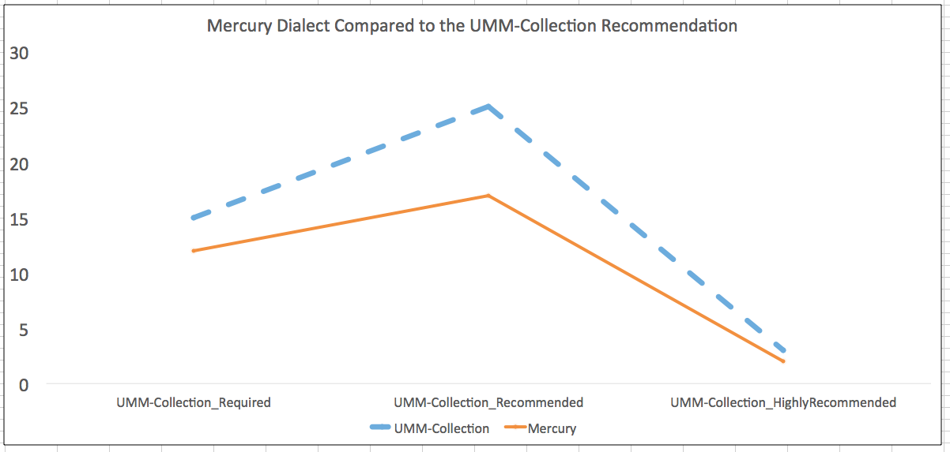
Recommendation / Dialect Comparison
data.ucar.edu
Identify gaps between dialects and recommendations
Sharable Metadata
Metadata
Documentation

Slide 5
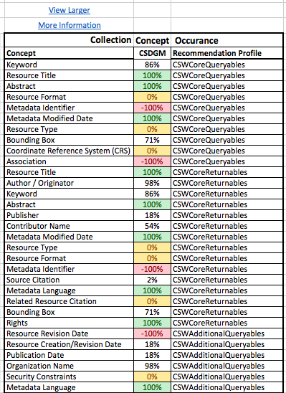
Collection Concept Occurrence %
Identify fields that are missing from dialect, missing from collection, complete, or partial
data.ucar.edu
Sharable Metadata
-100% = Concept Not in Dialect
Metadata
0% = Concept Not in Collection
100% = Concept in All Records
Documentation
54% = Concept in Some Records

Slide 6
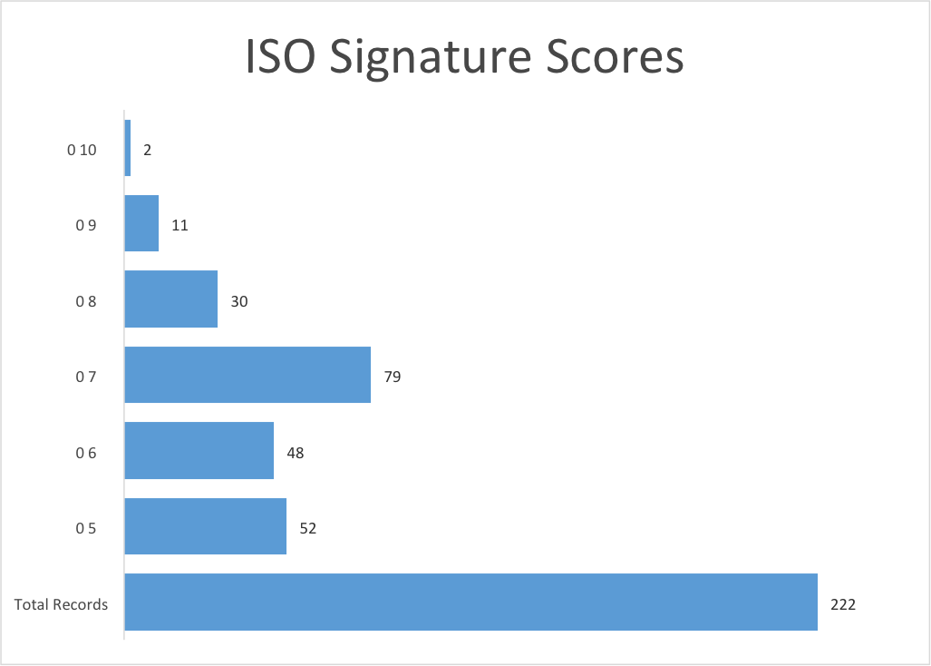
Signature Score Groups
data.ucar.edu
Identify groups of records that are missing the same number of fields (typically the same fields)
Sharable Metadata
Metadata

Slide 7
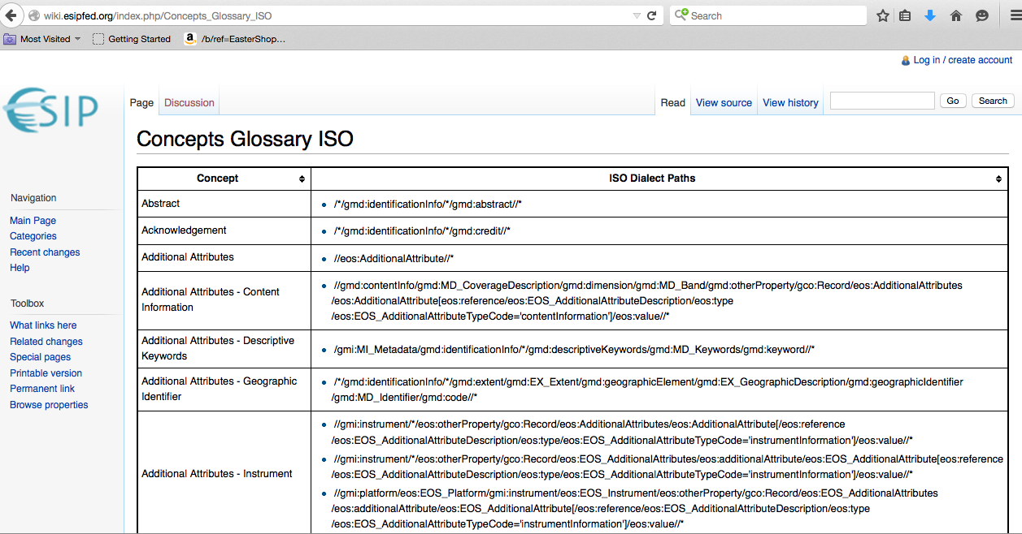
Concept Guidance Links
data.ucar.edu
Sharable Metadata
Metadata
Documentation

Slide 8
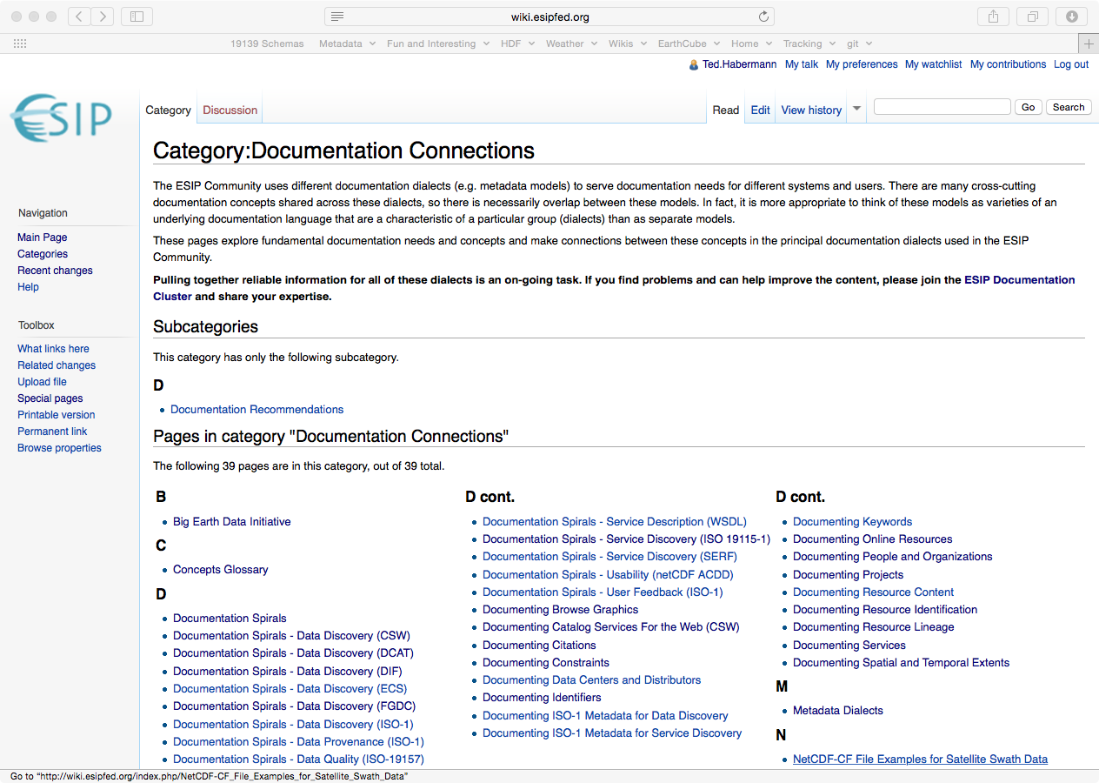
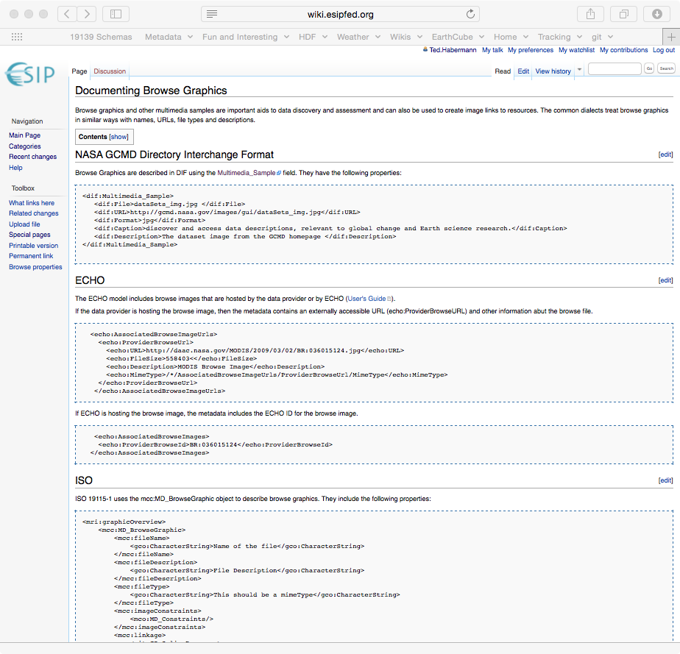
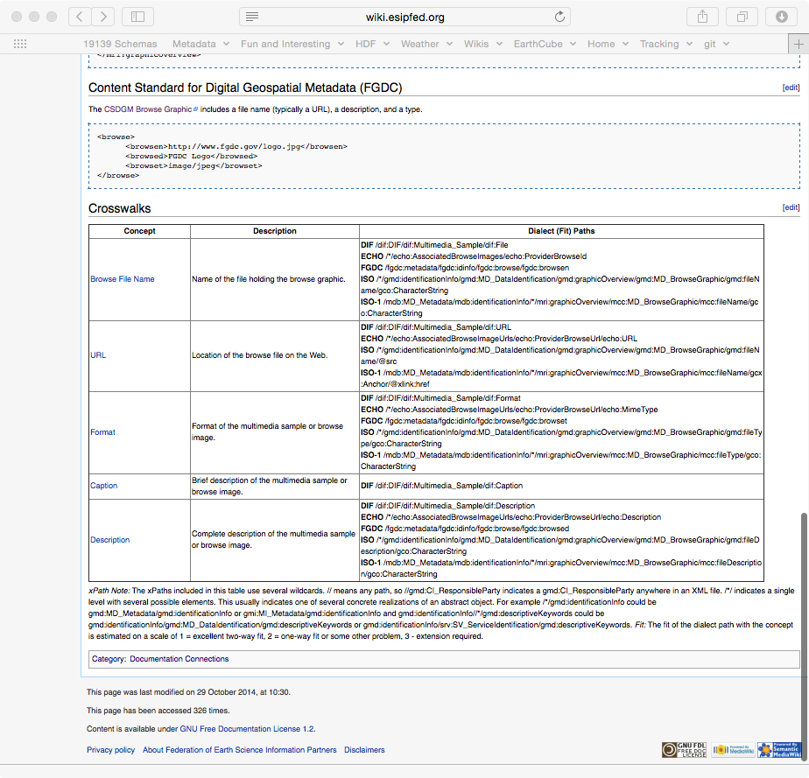
Guidance Documentation
data.ucar.edu
Sharable Metadata
Metadata
Documentation
http://wiki.esipfed.org/index.php/Category:Documentation_Connections

Slide 9
Prioritizing Metadata Improvement
What recommendations are most important to your organization?
a) DataCite, b) DCAT, c) DIF
What recommendation levels are most important to your organization?
- Not all recommendations are required
What concepts are missing from the most metadata records?
Fix the concept missing in 90% of your records before the concept missing in 7% if they are part of the same profile.
What concepts are missing from the multiple recommendations?
Improve completeness score for multiple recommendations by fixing 1 concept.
http://wiki.esipfed.org/index.php/Documentation_Recommendations

Slide 10
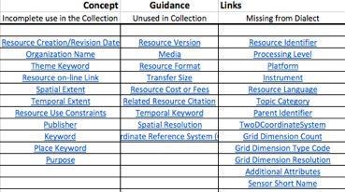
Metadata Improvement Guidance
How do I access online guidance for fixing missing concepts?
That’s great, but it doesn’t tell me how I identify which records are missing concepts…

Slide 11
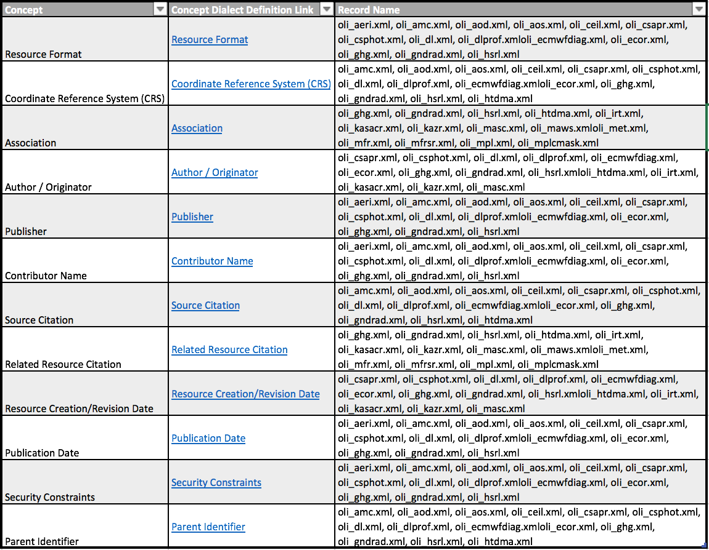
Which records do I need to improve?

Slide 12
How do I identify which records are missing concepts?
Links to xPaths in particular dialect

Slide 13
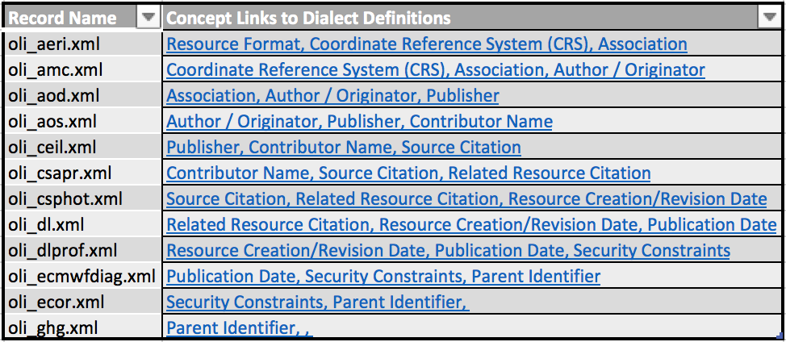
What concepts are missing in a single record?

Slide 14
Future Directions
Signature Score Sprints

Slide 15
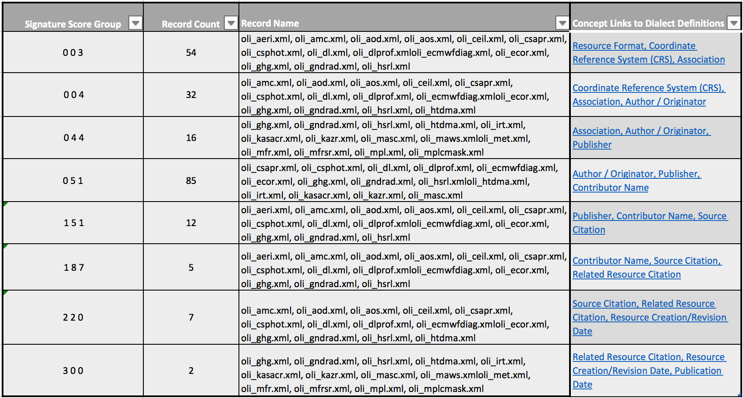
Signature Score Sprints

Slide 16
Metadata Improvement Process
Prioritize which concepts should be fixed first
Identify records with missing concepts
Curate the metadata.

Slide 17
Strengths of the workflow
Easy to read and understand
Metadata dialect is not limited to one standard
Community recommendation is not limited to one dialect
Use the results with your own system
Quick to add new recommendations
Direct quantitative guidance
Easily accessible guidance documentation

Slide 18
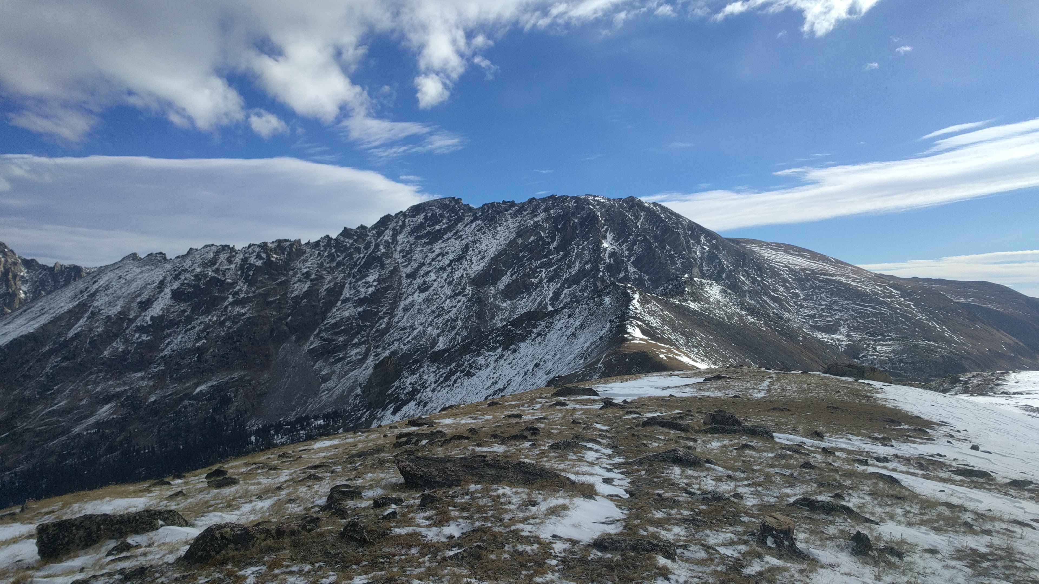
Questions?
Thank you!

